Slide 1
AI SATURDAYS LAGOS
MOVIESENSE: MOVIE RECOMMENDERS SYSTEM
BY TEAM SANKARA

Slide 2
ABOUT US
TEAM MEMBERS
Ifeoluwa Olugbade
Ogbobe Charles
Ehimwenman Edemakhiota

Slide 3
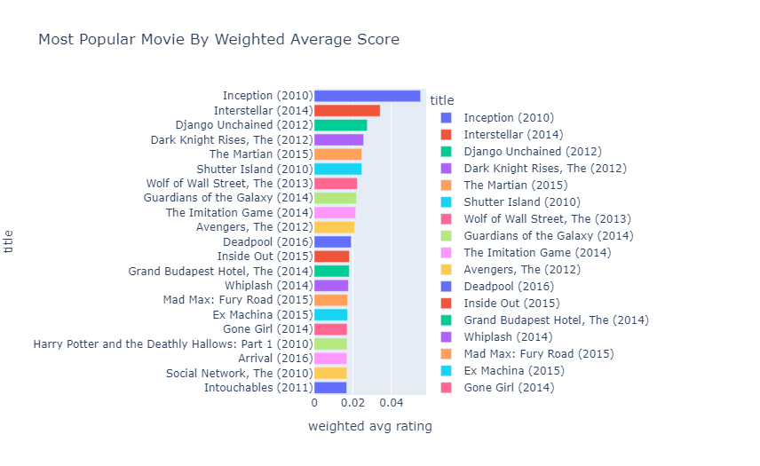
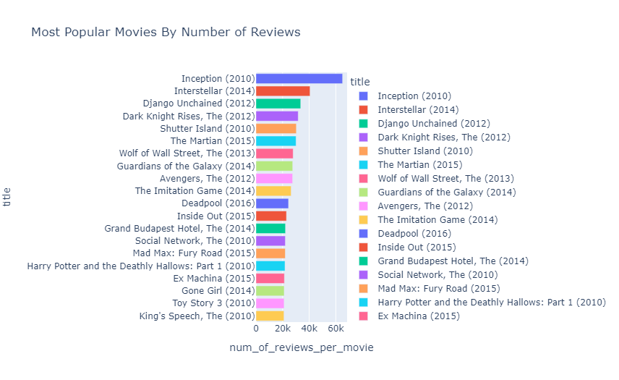
Data Cleaning and Exploration
Data Source: GroupLens
Consists of ratings,movies, genome-tags,links,genome-score and tags csv files
Focus was majorly on the ratings and movies csv files
Columns such as year, average rating, number of reviews, weighted rating were created in order to gain more insights.

Slide 4
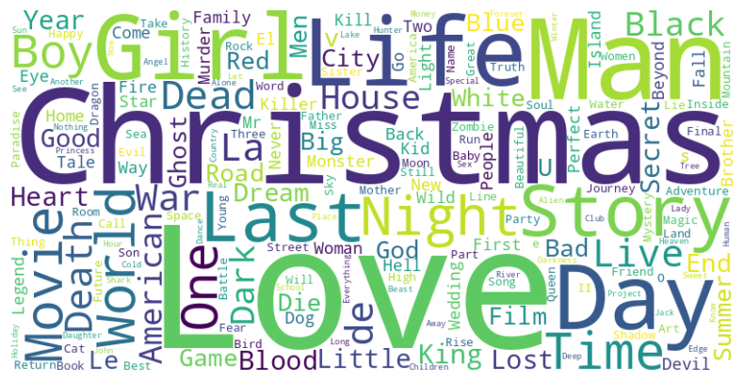
NaN values were dropped
A section from the data was cleaned and worked on for this project.
The selected data was for movies in the range of years 2010 - july,2023

Slide 5
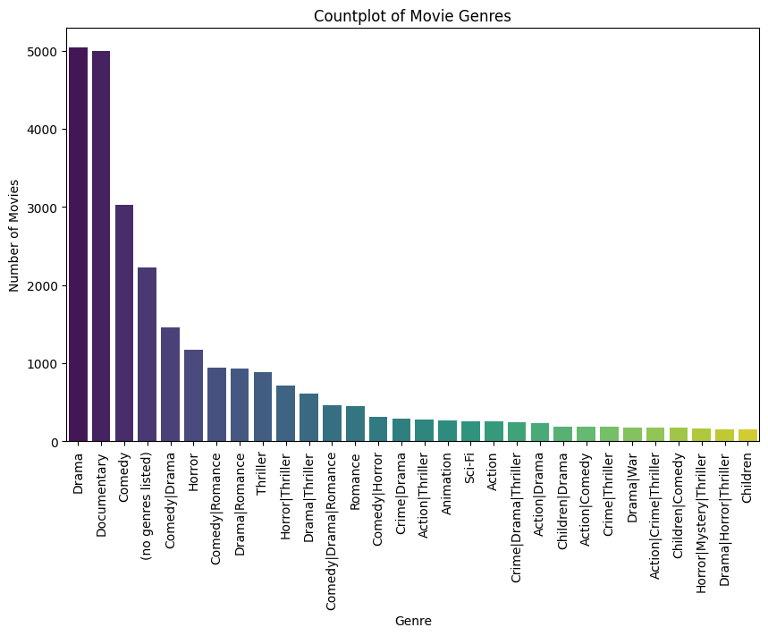
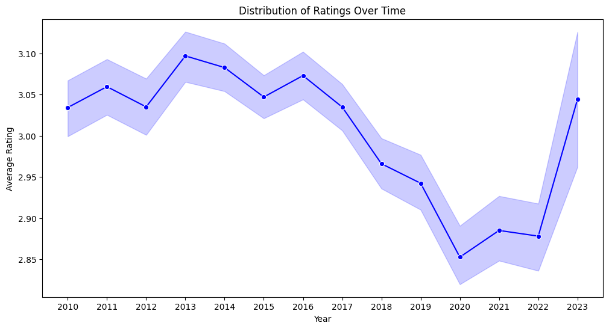
Some interesting and relevant visualizations were made from the data such as :
Number of movies vs Genre
Distribution of ratings over time
Word cloud of the movie titles
Popularity of movies by their weighted rating, percentage rating and number of reviews

Slide 6
The ML MODEL
We utilized content based filtering by comparing features of the data
It combines Natural Language processing technique the TF IDF and cosine similarity
Embeddings consisting of columns in the dataset: the tag, the title and the genre are created.
These embeddings are transformed into vectors by the TFIDF vectorizer which assigns weights to each word in the embeddings based on how frequently they appear
A cosine similarity is used to measure how closely the related these vectors are to each other

Slide 7
THE DEPLOYMENT
The GRADIO library used to build a web application
Web scraping techniques using the requests library
Api Queries to Tmdb.org and other libraries were used to obtain information relevant information such as the movie images, movie description and so on
The app comprises of three tabs : Trending, top rated, and search
Trending and top rated make use dataframe filtering and web scraping to display its contents
The search tab is where the model is used to suggest similar movies to the movie selected by the user

Slide 8
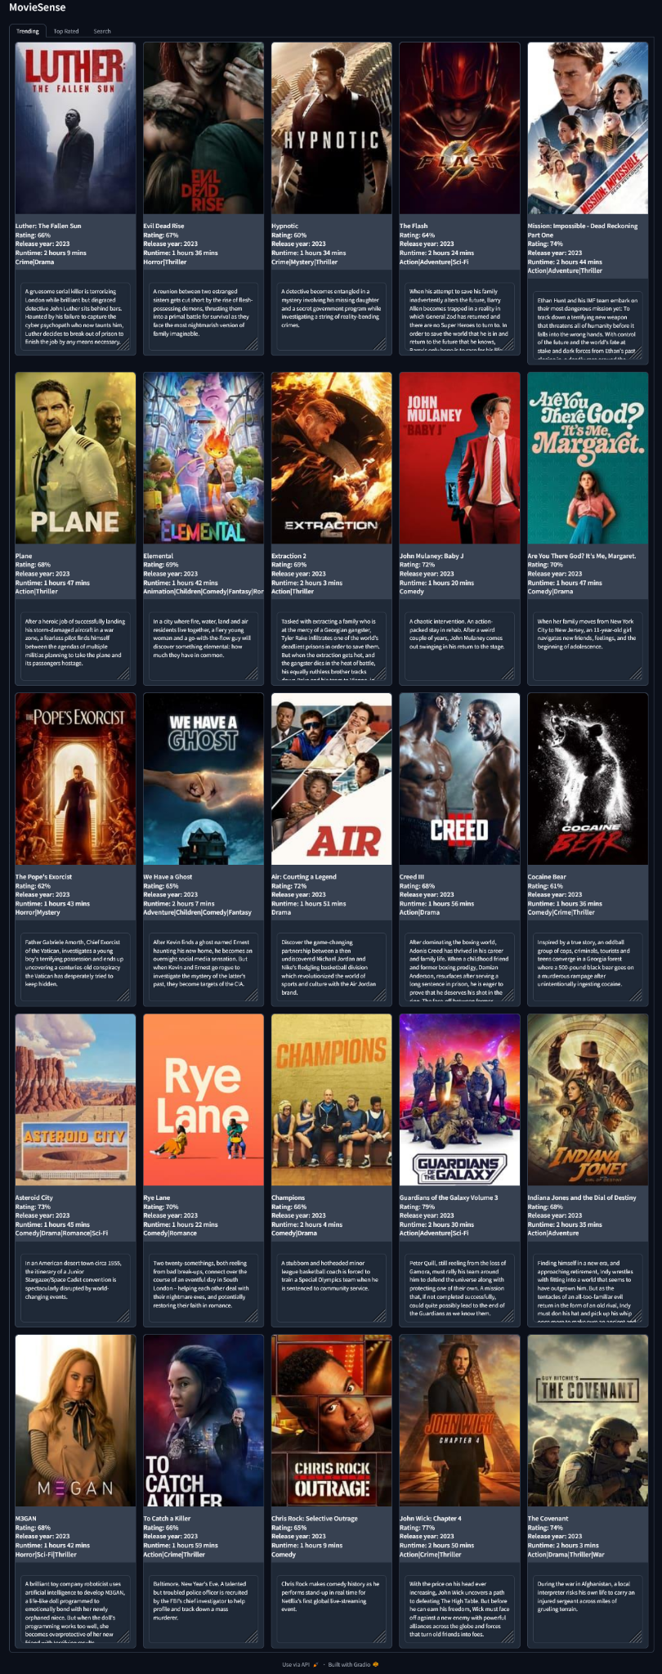
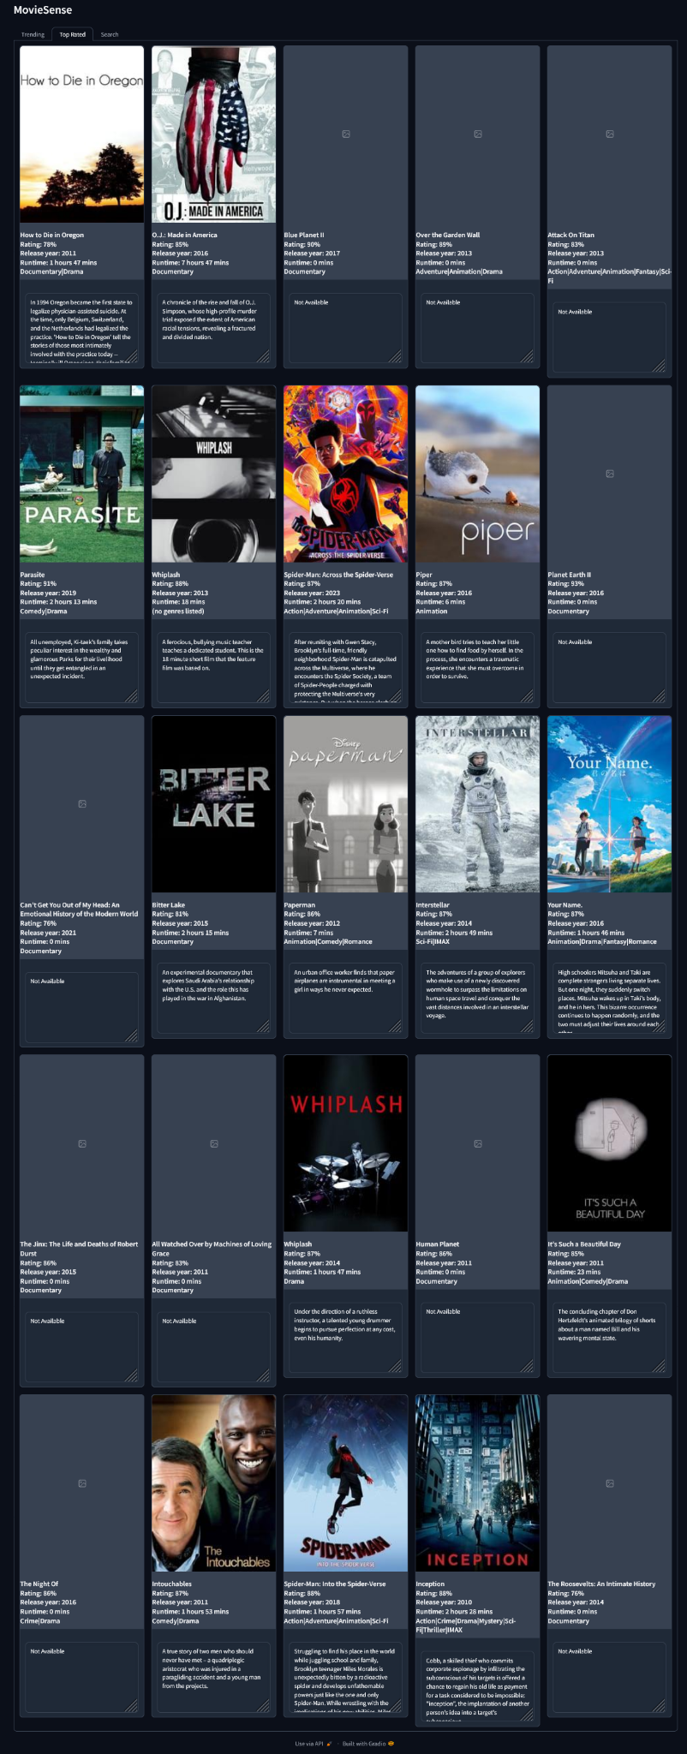
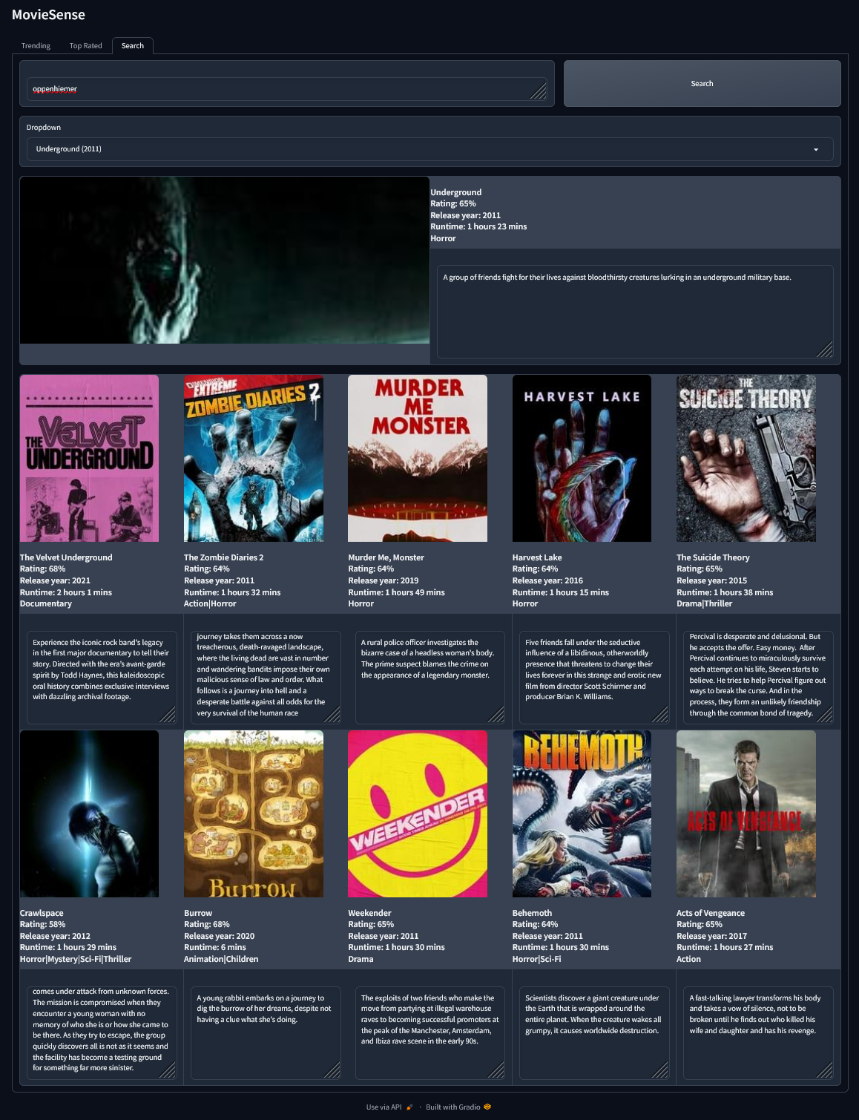
DEMONSTRATION

Slide 9
IMPROVEMENTS
Obtaining more reliable dataset and more information on movies
The model can improved by using techniques which capture semantic meaning and context such as a sentence transformer
Other robust APIs can be employed to get more complete information such as the movie images and descriptions

Slide 10
acknowledgement
The lecture videos referenced :
Week 3 lectures and Labs : Data Collection and web Scraping by Akintayo Jabar, Ejiro Onose
Week 5 lectures and Labs : Visualization and data collection by Oluwaseun Ajayi, Aseda Addai-Deseh
Week 7 Lectures and Labs : Free text and NLP by Wuraola Oyewusi and Fortune Adekogbe
Team Mentor: Onyeali David

Slide 11
Thank You

